Slide 1
Firewalls
Lesson Introduction
Part of network defense-in-depth
Types of firewall filtering
Deployment strategies
Notes:
Firewalls are part of the network defense-in-depth mechanisms. A firewall prevents intrusions to a network by filtering malicious packets.
In this lesson, we will discuss filtering techniques as well as firewall deployment strategies.

Slide 2
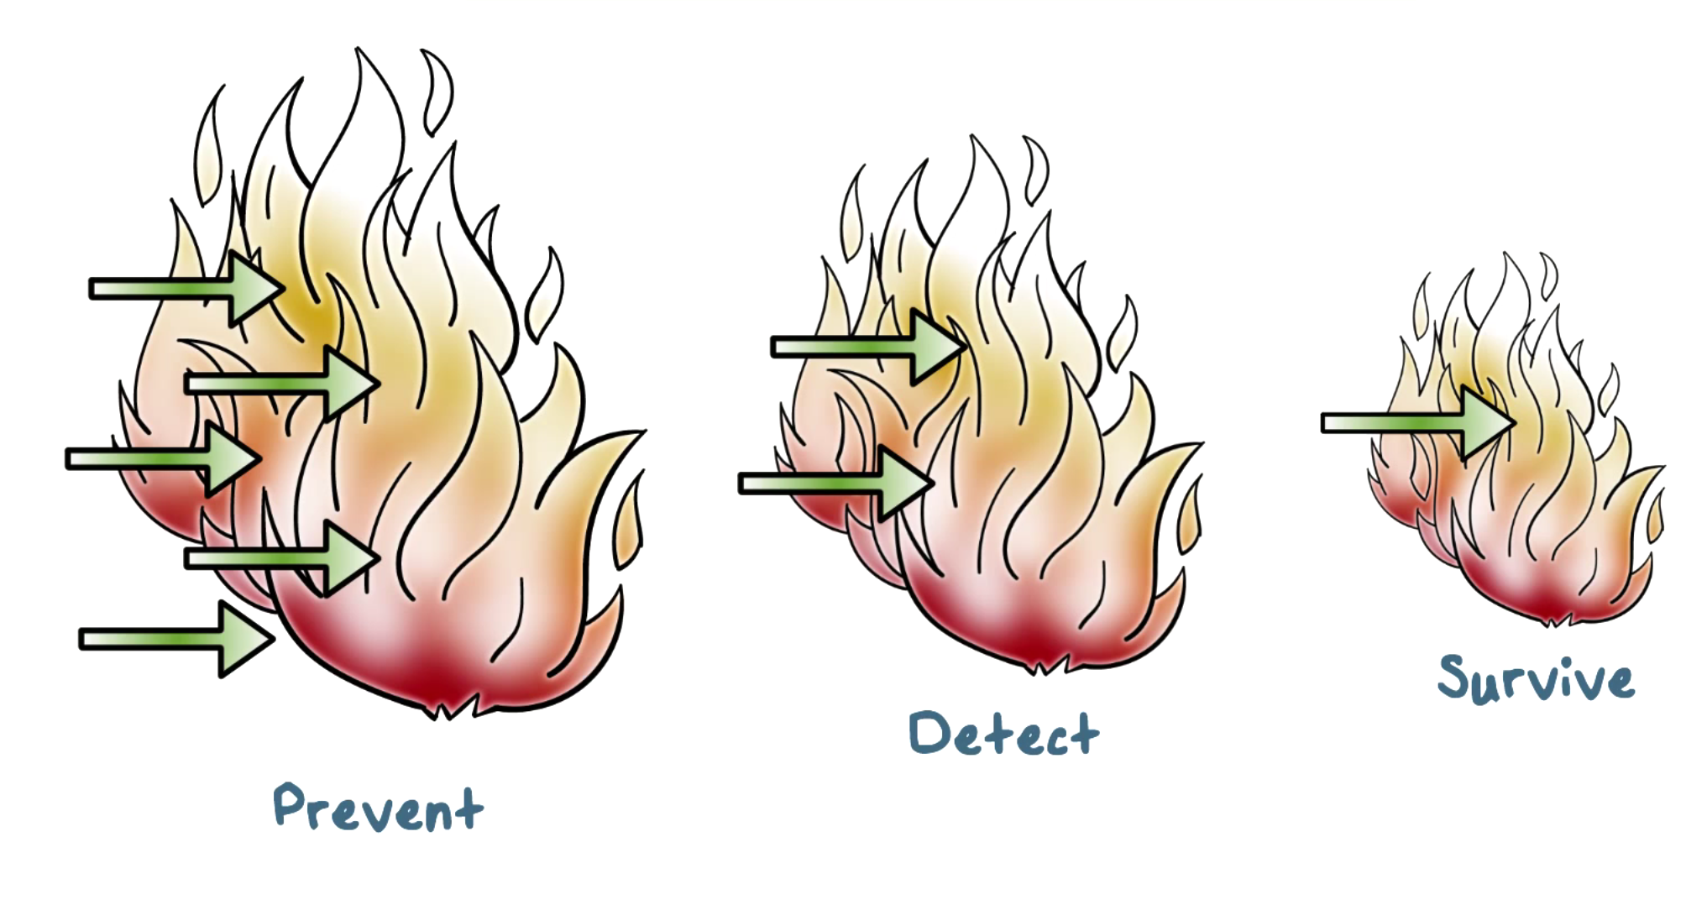
Defense-in-Depth
Notes:
PART 1
When it comes to defense against attacks, the most important principle is to employ defense-in-depth. In other words, we should deploy multiple layers of defense mechanisms.
The first line is a prevention mechanism that stops attacks from getting in our networks and systems. Inevitably, some attacks can defeat the prevention mechanisms. That is, there are “holes”, or, weaknesses, in the prevention mechanisms that allow some attacks to get through. For example, an attack can be a Javascript that can only be triggered by a specified time in the future, and so it’d not be possible for the prevention system to stop it now because it does not know or see the attack behavior yet.
PART 2
The second line is detection and response mechanisms that watch activities on systems and networks to detect attacks and repair the damages. Again, there will be attacks that can go undetected, at least for a while. For example, attacks that blend in with normal activities, such as the APT malware that is a malicious browser plug-in, would be hard to detect initially, not until its effects, such as data loss due to stolen credentials, manifest sometime later.
PART 3
The third line is attack-resilient technologies that enable the core elements, or, the most valuable systems, on the network to survive attacks and continue to function. For example, a server is a collection of diversified systems, that is, with different implementations, so that at least one of them will not be susceptible to the attack because an attack typically exploits specific vulnerabilities that only exist in some but not all implementations.

Slide 3
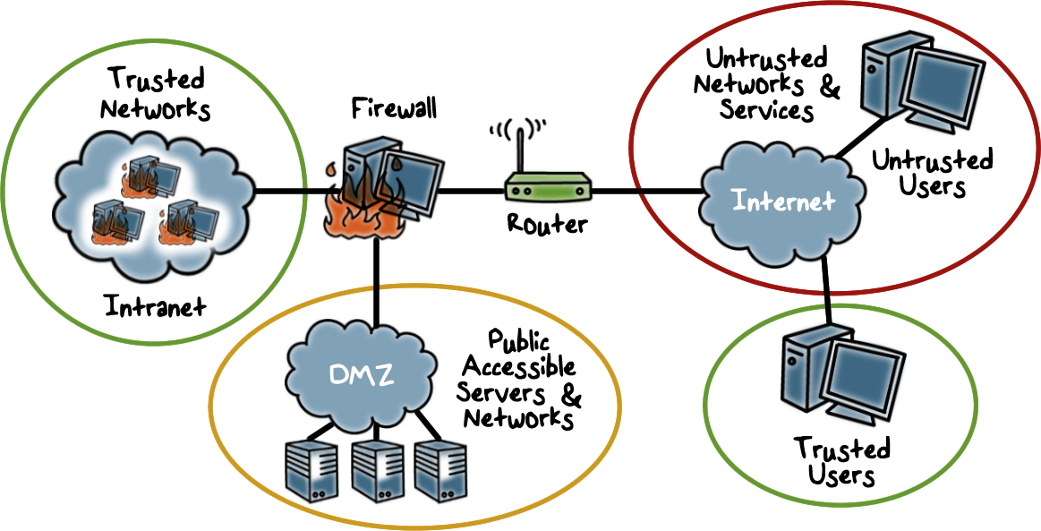
What is a Firewall?
Notes:
PART 1
Firewall is a widely-deployed prevention technology. To motivate the need for firewalls, let’s look at a typical enterprise network at a high-level.
An enterprise network is part of the Internet.
It typically has an internal and trusted part where only the company’s employee can access. For example, if this is a bank, the trusted part of its enterprise network has the internal email servers and systems that process financial transactions, and only authorized staff can access these systems.
The enterprise network can also have a public facing part. For example, the bank has a web site for its customers to log in or for the public to just learn about the bank. These public facing servers are in the so-called demilitarized zone, or, DMZ, that while it is part of the enterprise network, it is separated from the trusted network. For example, while customers can interact with the web server in the DMZ to log in and submit transaction request, they cannot directly access the servers in the trusted network that are authorizing and processing the transactions.
When a company has multiple physical sites, for example, a bank can have multiple branches in several cities. Typically, each site has its own local trusted network but the sites need to communicate with each other. For example, employees in one city, these are trusted users, need to access the corporate network at the headquarter in another city, and such access or traffic is from across the Internet, which is not trusted.
PART 2
How do we get traffic to its destination correctly on the Internet. We need routers. Each local or enterprise network has at least one router at its perimeter, and there are core routers on the Internet backbone. Together, these routers transport packets from one local network to the Internet backbone and onto the destination local network and the specific system.
PART 3
The routers can send traffic to the correct destination on the Internet. But as we discussed above, whether the network should allow such traffic depends on security considerations. For example, traffic from another trusted network, such as a branch office, should be allowed to the trusted network of the headquater. As another example, traffic from untrusted networks should only be allowed to the web servers in the DMZ. And access to the trusted network from DMZ is again restricted.
In short, we need a device that can enforce these different security restrictions on traffic. A firewall is such a device.
It is a device that provides secure connectivity between networks (for example, between internal and external, or trusted and untrusted networks, based on varying levels of trust)
It is used to implement and enforce a security policy for communication between networks.

Slide 4

Firewalls Quiz
Mark the box next to all those items that firewalls can stop:
Hackers breaking into your system
Internet traffic that appears to be from a legitimate source
Viruses and worms that spread through the internet
Spyware being put on your system
Viruses and worms that are spread through email
Notes:
QUIZ:
Although virtually all companies have firewalls in place, the number of security breaches continues to increase. The reason for this is, a firewall is not all things to all malware. There are some security breaches that cannot be stopped by a firewall. Look at this list check all those items that firewalls stop. We are going to discuss this topic in detail in the coming videos, so let’s do a quiz to get us in the right frame of mind. We will be discussing these throughout the lesson.
SOLUTION:
Firewalls cannot protect a your system from viruses and worms that are spread by email. A firewall can check that an email is from a legitimate source, but it cannot check the contents of the email itself
What Firewalls Do
Firewalls can protect your computer and your personal information from:
Hackers breaking into your system (attack traffic is often from untrusted parts of the Internet or even a known malicious sites, and a firewall can block it)
Viruses and worms that spread across the Internet (There are several ways to identify and block such traffic: such as the volume of such traffic or that such traffic has specially crafted packets that are known to target vulnerable services, or the traffic from the all over the Internet including the untrusted networks; The firewall can use such knowledge to block such virus and worm traffic).
Outgoing traffic from your computer created by a virus infection (This is similar to #2, except the traffic is outbound rather than inbound, )
What Firewalls Don’t Do
Firewalls cannot provide protection:
Against phishing scams and other fraudulent activity, spyware being installed on your computer, or viruses spread through e-mail (spyware: stealing information and send it out to a site; such site can appear to be legitimate or at least not know to be malicious, and the volume of traffic can be small; so it can be hard for a firewall to stop it)
Against Internet traffic that appears to be from a legitimate source (because firewall is designed to allow traffic from a legitimate source, e.g., another trusted network).

Slide 5

Firewall Design Goals
Enforcement of security policies
All traffic from internal network to the Internet, and vice versa, must pass through the firewall
Only traffic authorized by policy is allowed to pass
Dependable
The firewall itself is immune to subversion
Notes:
All attacks can be considered the result of violation of security policies.
Therefore, to prevent attacks, we need to enforce security policies.
At the high level, a security policy specifies what is allowed and whatever is not specified is by default not allowed. What is allowed means what is good or acceptable to the organization. Obviously, policy is organization-specific. We will come back to this point.
In terms of enforcement, the firewall is the gate that all traffic must pass through, in both directions: inbound and outbound.
In addition, the firewall must be dependable, for example, it cannot be crashed or disabled by an attack.

Slide 6

Firewall Access Policy
Lists the types of traffic authorized to pass through the firewall
Includes: address ranges, protocols, applications and content types
Notes:
A critical component in the planning and implementation of a firewall is specifying a suitable access policy.
What does the policy say? An access policy lists the types of traffic authorized to pass through the firewall, including address ranges, protocols, applications and content types.

Slide 7
Firewall Access Policy
Developed from the organization’s information security risk assessment and policy, and a broad specification of which traffic types the organization needs to support
Refined to detail the filter elements that can be implemented within an appropriate firewall topology
Notes:
How do we decide on the policies?
A policy should be developed from the organization’s information security risk assessment and policy; these topics are discussed in other lectures.
This policy should be developed from a broad specification of which traffic types the organization needs to support. It can then be implemented within an appropriate firewall topology.

Slide 8

Firewall Limitations
Firewalls cannot protect...
Traffic that does not cross it
Routing around
Internal traffic
When misconfigured
Notes:
Firewalls have limitations.
If traffic is not passed through a firewall, the firewall cannot examine such traffic and provide protection.
If the firewall is misconfigured, then even for traffic that passes through, the firewall cannot examine it correctly.

Slide 9

Additional, Convenient
Firewall Features
Gives insight into traffic
mix via logging
Network Address Translation
Encryption
Notes:
Firewalls also provide additional features.
Firewall can log all traffic that passes through, and the log can be analyzed later to learn about the traffic, such as traffic volume to specific part of the network.
It can also provide network address translation. This is useful when multiple machines in the internal network has to share an IPv4 address to the external networks on the Internet. The firewall translate the source IP address of an internal host to this shared IPv4 address for outbound traffic. And for inbound traffic, the firewall translates the destination IP to the IP address of an internal host.

Slide 10
Firewalls Features Quiz
Mark all the answers that apply:
Firewalls can stop/control:
Pings
Packet Sniffing
Outbound network
traffic
Malware can disable:
Software firewalls
Hardware firewalls
Antivirus checkers
Notes:
QUIZ:
A quick quiz on firewall features
SOLUTION:
Discuss the answers.
Malware can disable:
X-Software firewalls (if malware gets in the OS, it would have the privilege to disable software-based firewalls)
-Hardware firewalls (malware typically can’t control hardware settings)
X-Antivirus checkers (again, if malware gets in the OS, it would have the privilege to disable antivirus checkers or software)
Firewalls can stop/control
X-Pings (inbound ICMP packets can easily identified and blocked)
Packet Sniffing (typically passively recording packets in internal network, and so no activity is seen at firewall unless that attackers sends a huge amount of recorded traffic out, but typically the attacker would have a malware performing analysis of the recorded traffic in the internal network, and only sends the small amount of valuable data out)
X-Outbound network traffic (firewall looks at traffic in both directions)

Slide 11

Firewalls and Filtering
Packets checked then passed
Inbound & outbound affect when policy is checked
Notes:
The main mechanism in Firewalls is traffic filtering.

Slide 12
Filtering Types
Packet filtering
Access Control Lists
Session filtering
Dynamic Packet Filtering
Stateful Inspection
Context Based Access Control
Notes:
There two main types of filtering: based on per packet or session.

Slide 13

Packet Filtering
Decisions made on a per-packet basis
No state information saved
Notes:
Packet filtering is the simplest, and thus most efficient. But it is also not robust against attacks that span multiple packets where each packet by itself is not indicative of an attack.

Slide 14
Packet Filtering Firewall
Applies rules to each incoming and outgoing IP packet
Typically a list of rules based on matches in the IP or TCP header
Forwards or discards the packet based on rules match
Notes:
A packet filtering firewall applies a set of rules to each incoming and outgoing IP packet and then forwards or discards the packet. The firewall
is typically configured to filter packets going in both directions (from and to the internal network).

Slide 15
Packet Filtering Firewall
Filtering rules are based on information contained in a network packet:
Source IP address
Destination IP address
Source and destination transport-level address:
IP protocol field
Interface
Notes:
Filtering rules are based on information contained in a network packet:
• Source IP address: The IP address of the system that originated the IP packet
(e.g., 192.178.1.1)
• Destination IP address: The IP address of the system the IP packet is trying to
reach (e.g., 192.168.1.2)
• Source and destination transport-level address: The transport-level (e.g., TCP
or UDP) port number, which defines applications such as SNMP or TELNET
• IP protocol field: Defines the transport protocol (e.g., TCP, or UDP, ICMP)
• Interface: For a firewall with three or more ports, which interface of the firewall
the packet came from or which interface of the firewall the packet is destined for.
This is useful when there are multiple parts in the enterprise network that require different security policies.

Slide 16


Packet Filtering Firewall
Two default policies:
Discard - prohibit unless expressly permitted
More conservative, controlled, visible to users
Forward - permit unless expressly prohibited
Easier to manage and use but less secure
Notes:
The packet filter is typically set up as a list of rules based on matches to fields
in the IP or TCP header. If there is a match to one of the rules, that rule is invoked
to determine whether to forward or discard the packet. If there is no match to any
rule, then a default action is taken. Two default policies are possible:
• Default = discard: That which is not expressly permitted is prohibited.
• Default = forward: That which is not expressly prohibited is permitted.
The default discard policy is more conservative. Initially, everything is blocked,
and services must be added on a case-by-case basis. This policy is more visible to
users, who are more likely to see the firewall as a hindrance. However, this is the
policy likely to be preferred by businesses and government organizations. Further,
visibility to users diminishes as rules are created.
The default forward policy increases
ease of use for end users but provides reduced security; the security administrator must, in essence, react to each new security threat as it becomes known.
This policy may be used by generally more open organizations, such as universities.

Slide 17
Firewall Filtering Quiz
Rank each policy based on user convenience and security.
Use number 1 for best, 2, 3 for worst
Policy | Ease of Use | Security
Accepts only packets it knows are safe
Drops packets it knows are unsafe
Queries user about questionable packet
Notes:
QUIZ:
Rank each policy based on how user convenience and security.
(Use number 1 for best, 2, 3 for worst).
For example if you think a policy is the most user friendly, rate that policy ‘1’ for ease of use. If the policy is not very secure, put a ‘3’ in the security rating.
SOLUTION:
Discuss solutions
Bear in mind that, typically, our knowledge about attacks, or, unsafe traffic, is very limited, for example, because attackers constantly come up with new ways to attack our networks.
Rank each policy based on how user convenience and security.
(Use number 1 for best, 2, 3 for worst)
Policy: Ease of Use Security
Accepts only packets it knows are safe: 3 1
Drops packets it knows are unsafe 1 3
Queries user about questionable packet 2 2

Slide 18

Typical Firewall Configuration
If dynamic protocols are in use, entire ranges of ports must be allowed for the protocol to work.
Ports > 1024 left open
Notes:
Most standardized applications that run on top
of TCP follow a client/server model. For example, for the Simple Mail Transfer
Protocol (SMTP), e-mail is transmitted from a client system to a server system.
The client system generates new e-mail messages, typically from user input. The
server system accepts incoming e-mail messages and places them in the appropriate
user mailboxes. SMTP operates by setting up a TCP connection between client
and server, in which the TCP server port number, which identifies the SMTP server
application, is 25. The TCP port number for the SMTP client is a number between
1024 and 65535 that is generated by the SMTP client.
In general, when an application that uses TCP creates a session with a remote
host, it creates a TCP connection in which the TCP port number for the remote
(server) application is a number less than 1024 and the TCP port number for the
local (client) application is a number between 1024 and 65535. The numbers less
than 1024 are the “well-known” port numbers and are assigned permanently to
particular applications (e.g., 25 for server SMTP). The numbers between 1024 and
65535 are generated dynamically and have temporary significance only for the
lifetime of a TCP connection.
A simple packet filtering firewall must permit inbound network traffic on all
these high-numbered ports for TCP-based traffic to occur.

Slide 19
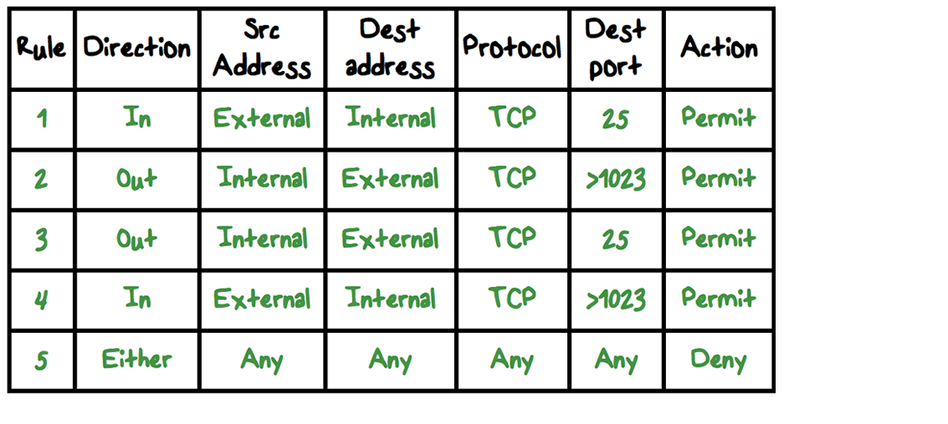
Packet Filtering Examples
Notes:
This is a simplified example of a rule set for SMTP traffic. The goal is to
allow inbound and outbound email traffic but to block all other traffic. The rules are
applied top to bottom to each packet. The intent of each rule is:
1. Inbound mail from an external source is allowed (port 25 is for SMTP incoming).
2. This rule is intended to allow a response to an inbound SMTP connection.
3. Outbound mail to an external source is allowed.
4. This rule is intended to allow a response to an inbound SMTP connection.
5. This is an explicit statement of the default policy. All rule sets include this rule
implicitly as the last rule.

Slide 20
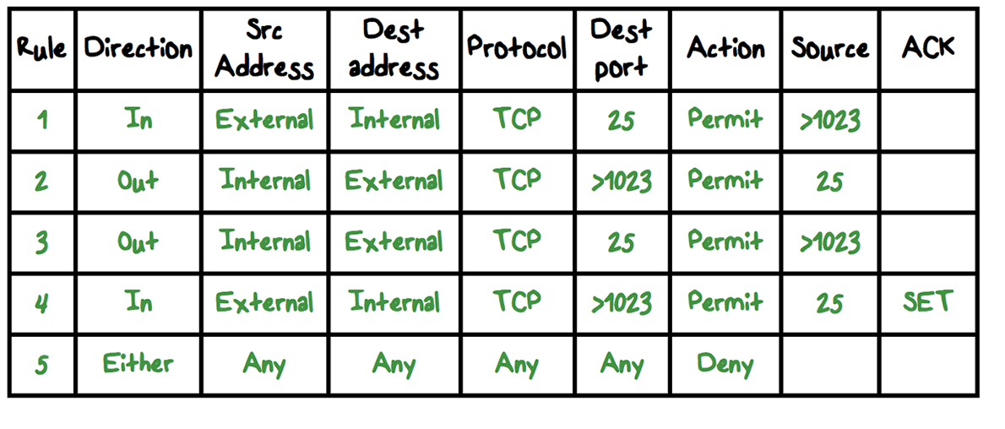
Modifying the Rules on Source Ports
Notes:
PART 1
There are several problems with this rule set.
Rule 4 allows external traffic to any destination port above 1023. As an example of an exploit of this rule, an external attacker can open a connection from the attacker’s port 5150 to an internal Web proxy server on port 8080. This is supposed to be forbidden and could allow an
attack on the server. To counter this attack, the firewall rule set can be configured with a source port field for each row. For rules 2 and 4, the source port is set to 25; for rules 1 and 3, the source port is set to >1023.
PART 2
But a vulnerability remains. Rules 3 and 4 are intended to specify that any
inside host can send mail to the outside. A TCP packet with a destination port of
25 is routed to the SMTP server on the destination machine. The problem with this
rule is that the use of port 25 for SMTP receipt is only a default; an outside machine could be configured to have some other application linked to port 25. As the revised
rule 4 is written, an attacker could gain access to internal machines by sending packets with a TCP source port number of 25. To counter this threat, we can add an
ACK flag field to each row. For rule 4, the field would indicate that the ACK flag
must be set on the incoming packet.
The rule takes advantage of a feature of TCP connections. Once a connection
is set up, the ACK flag of a TCP segment is set to acknowledge segments sent from
the other side. Thus, this rule allows incoming packets with a source port number of
25 that include the ACK flag in the TCP segment.

Slide 21
Packet Filtering Advantages
Advantages:
Simplicity
Typically transparent to users and are very fast
Notes:
One advantage of a packet filtering firewall is its simplicity. Also, packet filters
typically are transparent to users and are very fast.

Slide 22

Packet Filtering Weaknesses
Cannot prevent attacks that employ application specific vulnerabilities or functions
Limited logging functionality
Vulnerable to attacks and exploits that take advantage of TCP/IP
Packet filter firewalls are susceptible to security breaches caused by improper configurations
Notes:
weaknesses of packet filter firewalls:
• Because packet filter firewalls do not examine upper-layer data, they cannot
prevent attacks that employ application-specific vulnerabilities or functions.
For example, a packet filter firewall cannot block specific application commands; if a packet filter firewall allows a given application, all functions available within that application will be permitted.
• Because of the limited information available to the firewall, the logging functionality present in packet filter firewalls is limited. Packet filter logs
normally contain the same information used to make access control decisions (source address, destination address, and traffic type).
• Most packet filter firewalls do not support advanced user authentication schemes. Once again, this limitation is mostly due to the lack of upper-layer functionality by the firewall.
• Packet filter firewalls are generally vulnerable to attacks and exploits that take
advantage of problems within the TCP/IP specification and protocol stack, such as network layer address spoofing.
Many packet filter firewalls cannot detect a network packet in which the OSI Layer 3 addressing information has been altered.
Spoofing attacks are generally employed by intruders to bypass
the security controls implemented in a firewall platform.
• Finally, due to the small number of variables used in access control decisions, packet filter firewalls are susceptible to security breaches caused by improper configurations. In other words, it is easy to accidentally configure a packet filter firewall to allow traffic types, sources, and destinations that should be denied based on an organization’s information security policy.

Slide 23
Packet Filtering Firewall Countermeasures
IP Address spoofing Countermeasure: Discard packets with an inside source address if the packet arrives on an external interface.
Source Routing Attacks Countermeasure: Discard all packets in which the source destination specifies the route.
Tiny Fragment Attack Countermeasure: Enforcing a rule that the first fragment of a packet must contain a predefined minimum amount of the transport header
Notes:
Some of the attacks that can be made on packet filtering firewalls and the
appropriate countermeasures are the following:
• IP address spoofing : The intruder transmits packets from the outside with a
source IP address field containing an address of an internal host. The attacker
hopes that the use of a spoofed address will allow penetration of systems that
employ simple source address security, in which packets from specific trusted
internal hosts are accepted. The countermeasure is to discard packets with an
inside source address if the packet arrives on an external interface. In fact, this
countermeasure is often implemented at the router external to the firewall.
• Source routing attacks: The source station specifies the route that a packet
should take as it crosses the Internet, in the hopes that this will bypass security
measures that do not analyze the source routing information. A countermeasure
is to discard all packets that use this option.
• Tiny fragment attacks : The intruder uses the IP fragmentation option to create
extremely small fragments and force the TCP header information into a separate packet fragment. This attack is designed to circumvent filtering rules that depend on TCP header information. Typically, a packet filter
will make a filtering decision on the first fragment of a packet. All subsequent
fragments of that packet are filtered out solely on the basis that they are part of the packet whose first fragment was rejected. The attacker
hopes that the filtering firewall examines only the first fragment and that the remaining fragments are passed through.
A tiny fragment attack can be defeated by enforcing a rule that the first fragment of a packet must contain a predefined minimum amount of the transport header. If the first fragment is rejected, the filter can remember the packet and discard all subsequent
fragments.

Slide 24
Packet Filtering Quiz
In order for a fragmented packet to be successfully reassembled at the destination each fragment must obey the following rules. Mark all answers that are true:
Must not share a common fragment identification number.
Each fragment must say what its place or offset is in the original unfragmented packet.
Each fragment must tell the length of the data carried in the fragment.
Finally the fragment does not need to know whether more fragments follow this one.
Notes:
QUIZ:
Discuss packet filtering quiz
SOLUTION:
Discuss packet filtering quiz
#1 is false -- each fragment must share a common fragment id number
#4 is false -- each fragment must know whether more fragments follow it.

Slide 25
Stateful Inspection Firewall
Tightens rules for TCP traffic by creating a directory of TCP connections
There is an entry for each currently established connection
Packet filter will allows incoming traffic to high-numbered ports only for those packets that fit the profile of one of the entries in this directory
Reviews packet information but also records information about TCP connections
Keeps track of TCP sequence numbers to prevent attacks that depend on the sequence number,
Inspects data for protocols like FTP, IM, and SIPS commands
Notes:
In a stateful inspection firewall, a packet is analyzed and decision is made based on the context of other related packets, typically, this means the connection this packet belongs to.
Therefore, we need to record information about connections.

Slide 26
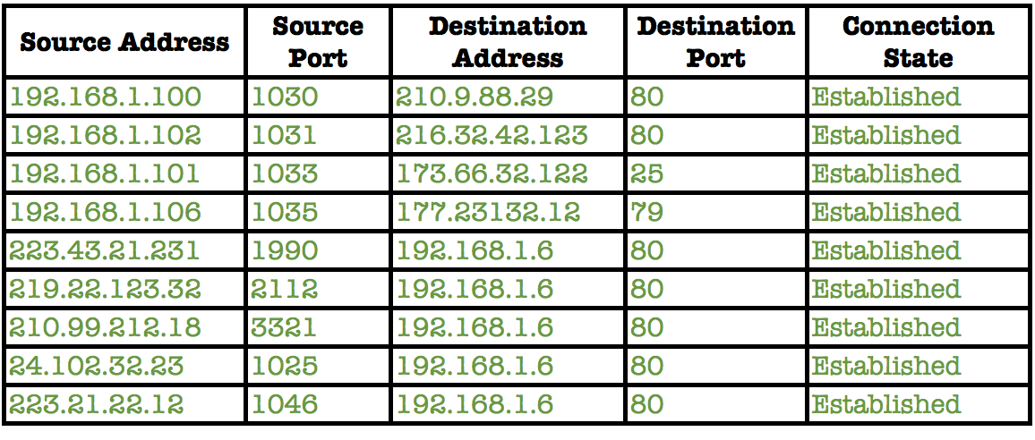
Connection State Table
Notes:
An example connection table, one record for each active connection.

Slide 27
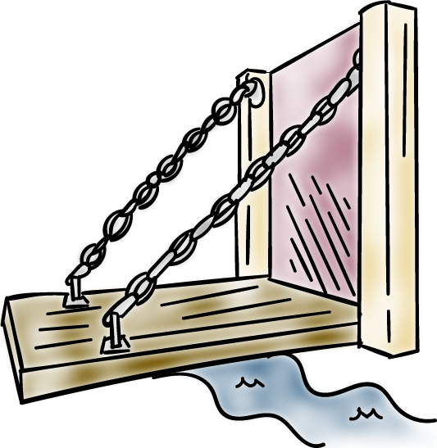
Application-Level Gateway
Also called an application proxy
Acts as a relay of application-level traffic (basically a man or system in the middle)
Notes:
Where packet and session filtering firewalls are the two main, or, more traditional types of firewalls. There are other more modern firewall types.
In particular, an application-level gateway, also called an application proxy , acts as a relay of
application-level traffic. It is essentially a man or system in the middle.

Slide 28
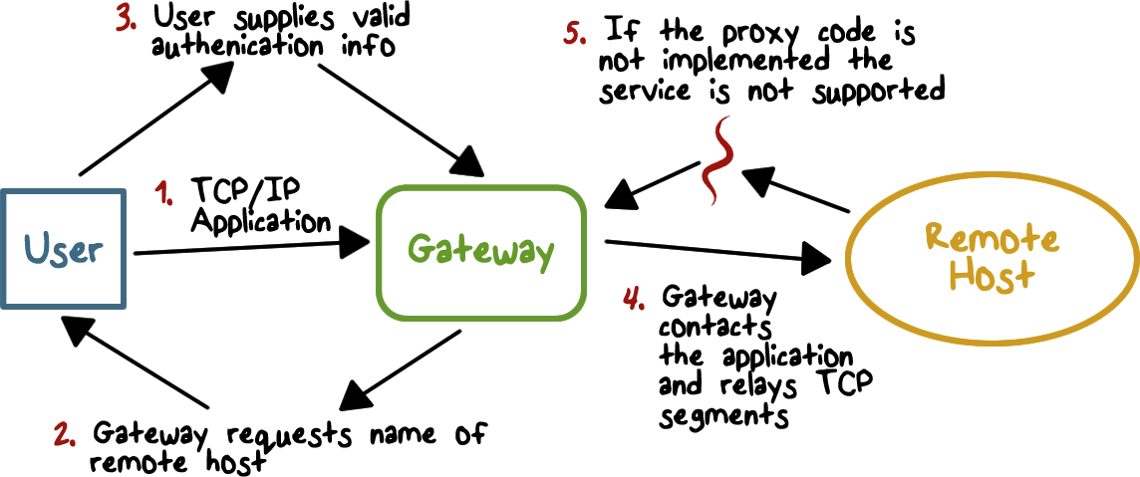
Application-Level Gateway
Notes:
The user contacts the gateway using a TCP/IP application, such as Telnet or FTP, and the gateway asks the user for the name of the remote host to be accessed. When the user responds and provides a valid user ID and authentication information, gateway contacts the application on the remote host and relays TCP segments containing the application data between the two endpoints. If the gateway does not implement the proxy code for a specific application, the service is not supported and cannot be forwarded across the firewall.

Slide 29
Application-Level Gateway
Must have proxy code for each application
May restrict application features supported
Tend to be more secure than packet filters
Disadvantage
Additional processing overhead on each connection
Notes:
Further, the gateway can be configured to support only specific features of an application that the network administrator considers acceptable while denying all other features, e.g., preventing active scripts in web pages; this can be accomplished by the proxy removing the scripts in pages returned by the remote server.
Application-level gateways tend to be more secure than packet filters. Rather than trying to deal with the numerous possible combinations that are to be allowed and forbidden at the TCP and IP level, the application-level gateway need only scrutinize a few allowable applications. In addition, it is easy to log and audit all incoming traffic at the application level.
A prime disadvantage of this type of gateway is the additional processing overhead on each connection. In effect, there are two spliced connections between the end users, with the gateway at the splice point, and the gateway must examine and forward all traffic in both directions.

Slide 30
Filtering Quiz
Mark each statement as either T for True of F for False:
A packet filtering firewall is typically configured to filter packets going in both directions.
A prime disadvantage of an application-level gateway is the additional processing overhead on each connection.
A packet filtering firewall can decide if the current packet is allowed based on another packet that it has just examined.
A stateful inspection firewall needs to keep track of information of an active connection in order to decide on the current packet.
Notes:
QUIZ: Mark each statement as either T for True of F for False
SOLUTION: Discuss answers

Slide 31

Bastion Hosts
Serves as a platform for an application-level gateway
System identified as a critical strong point in the network’s security
Notes:
Now let’s discuss firewall deployment strategy, that is, where in the network do we put a firewall.
A bastion host is a system identified by the firewall administrator as a critical strong
point in the network’s security. Typically, the bastion host serves as a platform for
an application-level or circuit-level gateway.

Slide 32
Bastion Hosts
Common characteristics:
Runs secure O/S, only essential services
May require user authentication to access proxy or host
Each proxy can restrict features, hosts accessed
Each proxy is small, simple, checked for security
Limited disk use, hence read-only code
Each proxy runs as a non-privileged user in a private and secured directory on the bastion host.
Notes:
Common characteristics of a bastion
host are as follows:
• The bastion host hardware platform executes a secure version of its operating
system, making it a hardened system.
• Only the services that the network administrator considers essential are
installed on the bastion host. These could include proxy applications for DNS,
FTP, HTTP, and SMTP.
• The bastion host may require additional authentication before a user is allowed
access to the proxy services. In addition, each proxy service may require its
own authentication before granting user access.
• Each proxy is configured to support only a subset of the standard application’s
command set.
• Each proxy is configured to allow access only to specific host systems. This
means that the limited command/feature set may be applied only to a subset
of systems on the protected network.
• Each proxy maintains detailed audit information by logging all traffic, each
connection, and the duration of each connection. The audit log is an essential
tool for discovering and terminating intruder attacks.
• Each proxy module is a very small software package specifically designed for network
security. Because of its relative simplicity, it is easier to check such modules
for security flaws. For example, a typical UNIX mail application may contain
over 20,000 lines of code, while a mail proxy may contain fewer than 1000.
• Each proxy is independent of other proxies on the bastion host. If there is a
problem with the operation of any proxy, or if a future vulnerability is discovered,
it can be uninstalled without affecting the operation of the other proxy
applications. Also, if the user population requires support for a new service, the
network administrator can easily install the required proxy on the bastion host.
• A proxy generally performs no disk access other than to read its initial configuration
file. Hence, the portions of the file system containing executable code
can be made read only. This makes it difficult for an intruder to install Trojan
horse sniffers or other dangerous files on the bastion host.
• Each proxy runs as a non-privileged user in a private and secured directory on
the bastion host.

Slide 33

Host Based Firewalls
Used to secure an individual host
Available in operating systems or can be provided as an add-on package
Filter and restrict packet flows
Common location is a server
Notes:
Firewalls are typically deployed at network perimeters.
But in additional to network firewalls, there are also host-based firewalls.
A host-based firewall is a software module used to secure an individual host,
that is, to enforce the host-specific security policy.
Such modules are available in many operating systems or can be provided as an add-on
package. Like conventional stand-alone firewalls, host-resident firewalls filter and
restrict the flow of packets.
A common location for such firewalls is a server.

Slide 34
Host Based Firewall Advantages
Advantages:
Filtering rules can be tailored to the host environment
Protection is provided independent of topology
Provides an additional layer of protection
Notes:
There are several advantages of the use of a server-based or workstation-based firewall:
• Filtering rules can be tailored to the host environment. Specific corporate
security policies for servers can be implemented, with different filters for
servers used for different application.
• Protection is provided independent of topology. Thus both internal and external
attacks must pass through the firewall.
• Used in conjunction with stand-alone network-based firewalls, the host-based firewall
provides an additional layer of protection. A new type of server can be added
to the network, with its own firewall, without the necessity of altering the
network firewall configuration.

Slide 35

Personal Firewalls
Controls traffic between a personal computer or workstation and the Internet or enterprise network
For both home or corporate use
Typically is a software module on a personal computer
Notes:
There are also personal firewalls.
A personal firewall controls the traffic between a personal computer or workstation
on one side and the Internet or enterprise network on the other side. Personal firewall
functionality can be used in the home environment and on corporate intranets.
Typically, the personal firewall is a software module on the personal computer.

Slide 36
Personal Firewalls
Can be housed in a router that connects all of the home computers to a DSL, cable modem, or other Internet interface
Typically much less complex than server-based or stand-alone firewalls
Primary role is to deny unauthorized remote access
May also monitor outgoing traffic to detect and block worms and malware activity
Notes:
In a home environment with multiple computers connected to the Internet, firewall
functionality can also be housed in a router that connects all of the home computers
to a DSL, cable modem, or other Internet interface.
Personal firewalls are typically much less complex than either server-based
firewalls or stand-alone firewalls. The primary role of the personal firewall is to
deny unauthorized remote access to the computer. The firewall can also monitor
outgoing activity in an attempt to detect and block worms and other malware.
Personal firewall capabilities are provided by the netfilter package on Linux
systems, or the pf package on BSD and Mac OS X systems. These packages may be
configured on the command-line, or with a GUI front-end. When such a personal
firewall is enabled, all inbound connections are usually denied except for those
the user explicitly permits. Outbound connections are usually allowed.

Slide 37
Personal Firewalls - Common Services
Personal file sharing (548, 427)
Windows sharing (139)
Personal Web sharing (80, 427)
Remote login—SSH (22)
FTP access (20-21, 1024-65535 from 20-21)
Remote Apple events (3031)
Printer sharing (631, 515)
IChat Rendezvous (5297, 5298)
ITunes Music Sharing (3869)
CVS (2401)
Gnutella/Limewire (6346)
ICQ (4000)
IRC (194)
MSN Messenger (6891-6900)
Network Time (123)
Retrospect (497)
SMB (without netbios–445)
VNC (5900-5902)
WebSTAR Admin (1080, 1443)
Notes:
The list of inbound services that can be selectively re-enabled, with their port numbers, may include the following common services:
• Personal file sharing (548, 427)
• Windows sharing (139)
• Personal Web sharing (80, 427)
• Remote login—SSH (22)
• FTP access (20-21, 1024-65535 from 20-21)
• Remote Apple events (3031)
• Printer sharing (631, 515)
• IChat Rendezvous (5297, 5298)
• ITunes Music Sharing (3869)
CVS (2401)
• Gnutella/Limewire (6346)
• ICQ (4000)
• IRC (194)
• MSN Messenger (6891-6900)
• Network Time (123)
• Retrospect (497)
• SMB (without netbios–445)
• VNC (5900-5902)
• WebSTAR Admin (1080, 1443)
When FTP access is enabled, ports 20 and 21 on the local machine are opened
for FTP; if others connect to this computer from ports 20 or 21, the ports 1024
through 65535 are open.

Slide 38

Advanced Firewall Protection
Stealth Mode hides the system from the internet by dropping unsolicited communication packets
UDP packets can be blocked
Logging for checking on unwanted activity
Applications must have authorization to provide services
Notes:
For increased protection, advanced firewall features may be configured. For
example, stealth mode hides the system on the Internet by dropping unsolicited
communication packets, making it appear as though the system is not present.
UDP packets can be blocked, restricting network traffic to TCP packets only for
open ports. The firewall also supports logging, an important tool for checking on
unwanted activity. Other types of personal firewall allow the user to specify that
only selected applications, or applications signed by a valid certificate authority,
may provide services accessed from the network.

Slide 39
Personal Firewalls Quiz
A company has a conventional firewall in place on its network. Which (if any) of these situations requires an additional personal firewall?
An employee uses a laptop on the company network and at home.
An employee uses a desktop on the company network to access websites worldwide
A remote employee uses a desktop to create a VPN on the company’s secure network.
None of the above, in each case the employee’s computer is protected by the company firewall.
Notes:
QUIZ: Chose the situations where you think a personal firewall should be installed.
SOLUTION: Discuss answers
A company has a conventional firewall in place on its network. Which (if any) of these situations requires an additional personal firewall?
X- An employee uses a laptop on the company network and at home.
-An employee uses a desktop on the company network to access websites worldwide
X -A remote employee uses a desktop to create a VPN on the company’s secure network.
-None of the above, in each case the employee’s computer is protected by the company firewall.

Slide 40
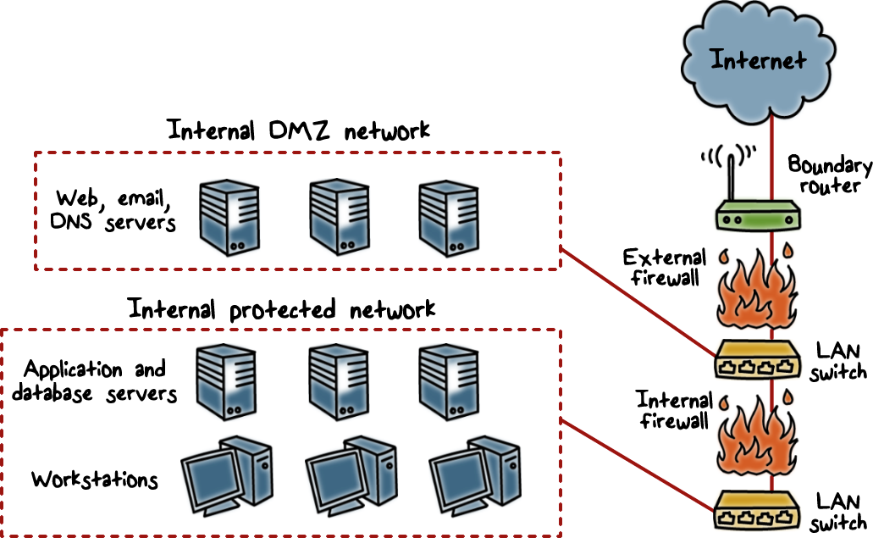
Deploying Firewalls
Notes:
How should firewalls be deployed to protect a network?
Here is a figure that illustrates a common firewall configuration that includes an additional
network segment between an internal and an external firewall.
An external firewall is placed at the edge of a local or enterprise network, just
inside the boundary router that connects to the Internet or some wide area network
(WAN). One or more internal firewalls protect the bulk of the enterprise network.
Between these two types of firewalls are one or more networked devices in a
region referred to as a DMZ (demilitarized zone) network. Systems that are externally
accessible but need some protections are usually located on DMZ networks.
Typically, the systems in the DMZ require or foster external connectivity, such as a
corporate Web site, an e-mail server, or a DNS (domain name system) server.
The external firewall provides a measure of access control and protection for
the DMZ systems consistent with their need for external connectivity. The external
firewall also provides a basic level of protection for the remainder of the enterprise
network.

Slide 41

Internal Firewalls
Internal Firewall Purposes:
Add more stringent filtering capability
Provide two-way protection with respect to the DMZ
Multiple firewalls can be used to protect portions of the internal network from each other
Notes:
In this type of configuration, internal firewalls serve three purposes:
1. The internal firewall adds more stringent filtering capability, compared to the
external firewall, in order to protect enterprise servers and workstations from
external attack.
2. The internal firewall provides two-way protection with respect to the DMZ.
First, the internal firewall protects the remainder of the network from attacks
launched from DMZ systems. Such attacks might originate from worms, rootkits,
bots, or other malware lodged in a DMZ system. Second, an internal firewall can
protect the DMZ systems from attack from the internal protected network.
3. Multiple internal firewalls can be used to protect portions of the internal
network from each other.

Slide 42
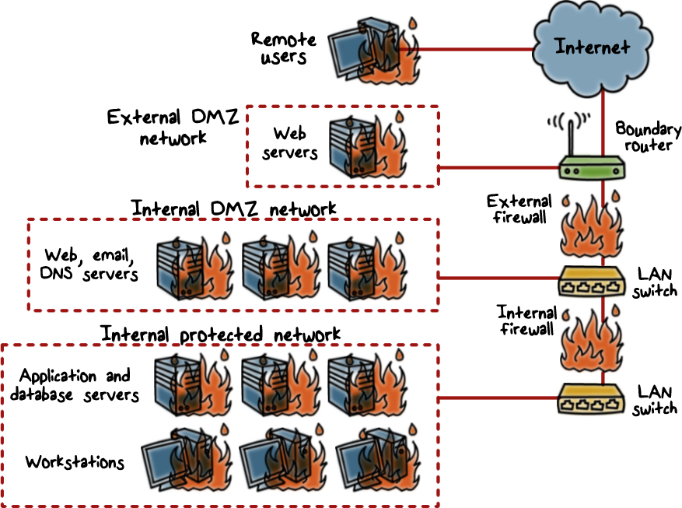
Distributed Firewall Deployment
Notes:
Here is a figure showing a distributed deployment scenario.
A distributed firewall configuration involves stand-alone firewall devices plus host-based
firewalls working together under a central administrative control. This figure
suggests a distributed firewall configuration. Administrators can configure host
resident firewalls on hundreds of servers and workstation as well as configure
personal firewalls on local and remote user systems. Tools let the network administrator
set policies and monitor security across the entire network. These firewalls protect against internal attacks and provide protection tailored to specific machines and applications. Stand-alone firewalls provide global protection, including internal
firewalls and an external firewall, as discussed previously.
With distributed firewalls, it may make sense to establish both an internal and an external DMZ. Web servers that need less protection because they have less critical information on them could be placed in an external DMZ, outside the
external firewall. What protection is needed is provided by host-based firewalls on
these servers.

Slide 43
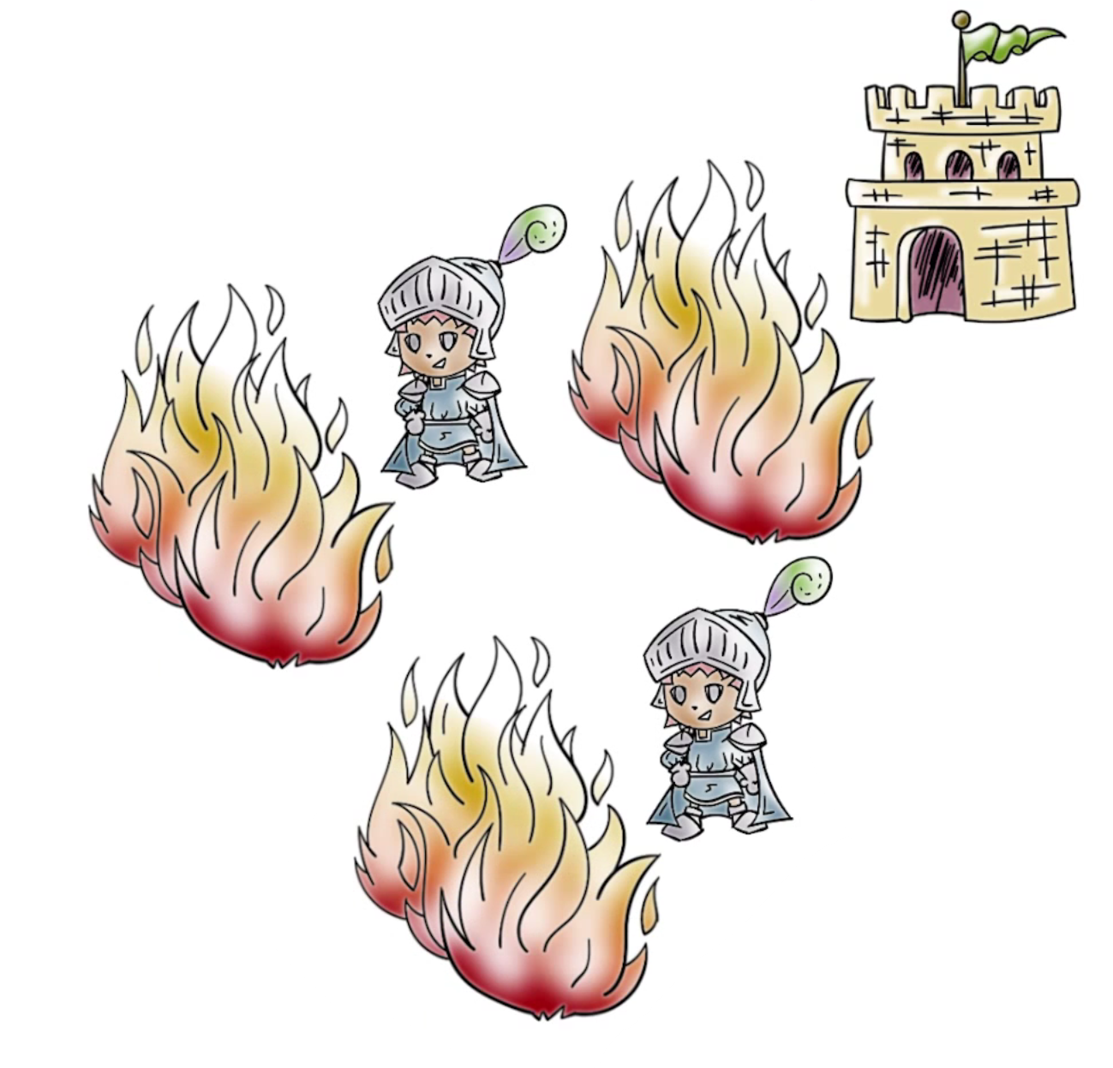
Distributed Firewall Deployment
An important aspect of distributed firewall configuration:
Security Monitoring
Notes:
An important aspect of a distributed firewall configuration is security monitoring. Such monitoring typically includes log aggregation and analysis, firewall statistics, and fine-grained remote monitoring of individual hosts if needed.

Slide 44
Firewall Deployment Quiz
Choose the most correct answer and enter the corresponding letter in the text box.
Typically the systems in the require or foster external connectivity such as a corporate Web site, an e-mail server, or a DNS server.
A. DMZ
B. IP protocol field
C. boundary firewall
D. VPN
Notes:
QUIZ:
For this quiz I would like you to chose the most correct answer and enter the corresponding letter in the text box.
A quiz on Firewall deployment in an enterprise network.
SOLUTION: Discuss answers

Slide 45
Stand-alone Firewall Quiz
Choose the most correct answer and enter the corresponding letter in the text box.
A configuration involves stand-alone firewall devices plus host-based firewalls working together under a central administrative control.
A. packet filtering firewall
B. distributed firewall
C. personal firewall
D. stateful inspection firewall
Notes:
QUIZ: For this quiz I would like you to chose the most correct answer and enter the corresponding letter in the text box.
A quiz on Firewall deployment in an enterprise network.
SOLUTION:
Discuss answers

Slide 46
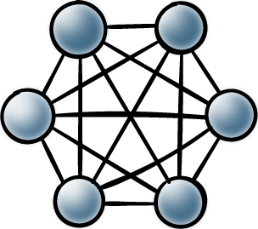
Firewall Topologies
Host-resident firewall: includes personal firewall software and firewall software on servers
Screening router: single router between internal and external networks with stateless or full packet filtering
Single bastion inline: single firewall device between an internal and external router
Single bastion T: has a third network interface on bastion to a DMZ where externally visible servers are placed.
Double bastion inline: DMZ is sandwiched between bastion firewalls.
Double bastion T: DMZ is on a separate network interface on the bastion firewall
Distributed firewall configuration: used by some large businesses and government organizations
Notes:
FIRST LAYER:
We can now summarize a spectrum of firewall locations and topologies.
The following alternatives can be identified:
• Host-resident firewall: This category includes personal firewall software and
firewall software on servers. Such firewalls can be used alone or as part of an
in-depth firewall deployment.
NEXT LAYER:
• Screening router: A single router between internal and external networks with
stateless or full packet filtering. This arrangement is typical for small office/
home office (SOHO) applications.
NEXT LAYER:
Single bastion inline: A single firewall device between an internal and external
router . The firewall may implement stateful filters and/
or application proxies. This is the typical firewall appliance configuration for
small to medium-sized organizations.
NEXT LAYER:
Single bastion T: Similar to single bastion inline but has a third network interface
on bastion to a DMZ where externally visible servers are placed. Again,
this is a common appliance configuration for medium to large organizations.
NEXT LAYER:
Double bastion inline: where the
DMZ is sandwiched between bastion firewalls. This configuration is common
for large businesses and government organizations.
NEXT LAYER:
• Double bastion T: The DMZ is on
a separate network interface on the bastion firewall. This configuration is
also common for large businesses and government organizations and may
be required.
NEXT LAYER:
• Distributed firewall configuration: This configuration
is used by some large businesses and government organizations.

Slide 47
Firewalls
Lesson Summary
Enforce security policy to prevent attacks by way of traffic filtering; default deny
Packet filtering and session filtering, application-level gateway
Host-based firewalls, screen router, bastion hosts, and DMZ
Notes:
Firewalls prevents attacks by way of traffic filtering. Default policy is deny, that is, unless explicitly allowed, traffic is filtered, or, disallowed.
There are several types traffic filtering techniques that firewalls can use: packet filtering, session filtering, and application gateway.
Firewalls can be deployed at network perimeter, end-hosts, servers, and can be used to create a DMZ.

